Slide 1

David M. Kroenke and David J. Auer Database Processing: Fundamentals, Design, and Implementation
Chapter Seven:
SQL for Database Construction
and Application Processing

Slide 2
Chapter Objectives
To create and manage table structures using SQL statements
To understand how referential integrity actions are implemented in SQL statements
To create and use SQL constraints
To understand several uses for SQL views
To use SQL statements to create and use views
To understand how SQL is used in an application programming
To understand SQL/Persistent Stored Modules (SQL/PSM)
To understand how to create and use functions
To understand how to create and use triggers
To understand how to create and use stored procedures

Slide 3
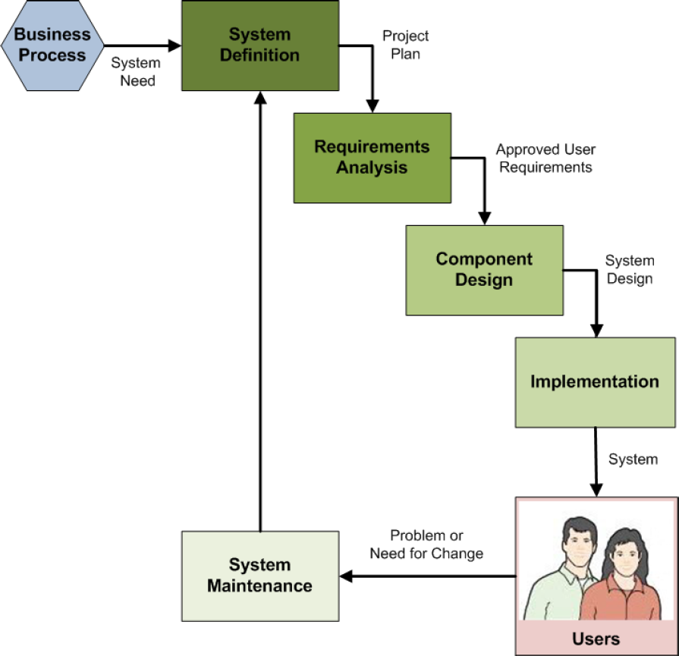
Data Modeling in the SDLC
The systems development life cycle (SDLC) as discussed in Appendix B
Database construction occurs in the implementation step of the SDLC
The final database is part of the final system ready for users to use

Slide 4

View Ridge Gallery

Slide 5
View Ridge Gallery
View Ridge Gallery is a small art gallery that has been in business for 30 years.
It sells contemporary European and North American fine art.
View Ridge has one owner, three salespeople, and two workers.
View Ridge owns all of the art that it sells; it holds no items on a consignment basis.

Slide 6
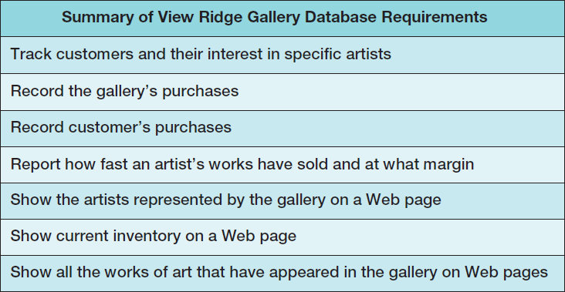
VRG Application Requirements

Slide 7
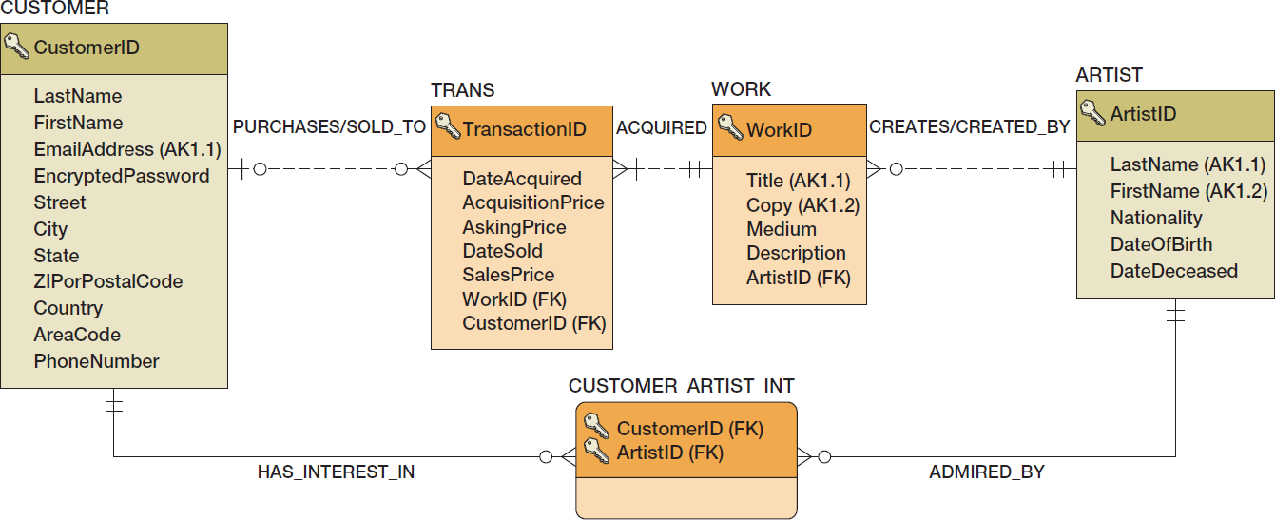
VRG Database Design

Slide 8
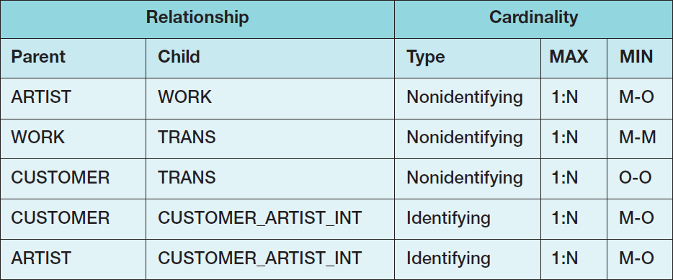
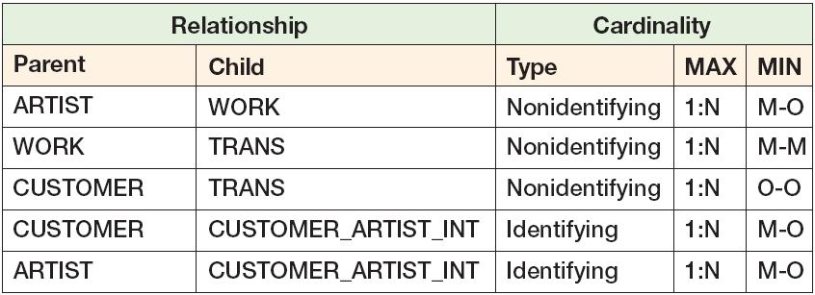
Minimum Cardinality Enforcement: VRG Database Relationships

Slide 9
VRG Database Available Online I
Versions of the complete VRG database are available in the downloadable Student Files available at:
http://www.pearsonhighered.com/kroenke/
These include versions for:
Microsoft Access 2013
Microsoft SQL Server 2014
Oracle Database 12c and Oracle Database XE
MySQL 5.6
We recommend you actually run all material in a live database!

Slide 10
VRG Database Available Online II
To complete setting up the VRG database, set the referenced materials:
For Microsoft SQL Server 2014:
See Online Chapter 10A
For Oracle Database 12c and Oracle Database XE:
See Online Chapter 10B
For MySQL 5.6
See Online Chapter 10C
Online chapters 10A, 10B, and 10C are available for download at:
http://www.pearsonhighered.com/kroenke/

Slide 11
SQL Categories
SQL statements can be divided into five categories:
Data definition language (DDL)
Data manipulation language (DML) statements
SQL/Persistent Stored Modules (SQL/PSM) statements
Transaction control language (TCL) statements
Data control language (DCL) statements

Slide 12
SQL DDL
Data definition language (DDL) statements
Used for creating tables, relationships, and other structures
Covered in this chapter (Chapter 7)

Slide 13
SQL DML
Data manipulation language (DML) statements
Used for:
Queries – SQL SELECT statement
Inserting data – SQL INSERT statement
Modifying data – SQL UPDATE statement
Deleting data – SQL DELETE statement
Previously covered in Chapter 2

Slide 14
SQL SQL/PSM
SQL/Persistent Stored Modules (SQL/PSM) statements
Add procedural programming capabilities
Variables
Control-of-flow statements
Covered in Chapters:
This chapter (Chapter 7) [general introduction]
10A (SQL Server 2014)
10B (Oracle Database)
10C (MySQL 5.6)

Slide 15
SQL TCL
Transaction control language (TCL) statements
Used to mark transaction boundaries and control transaction behavior
Covered in Chapters:
9 (general introduction)
10A (SQL Server 2014)
10B (Oracle Database)
10C (MySQL 5.6)

Slide 16
SQL DCL
Data control language (DCL) statements
Used to grant (or revoke) database permissions to (from) users and groups
Covered in Chapters:
9 (general introduction)
10A (SQL Server 2014)
10B (Oracle Database)
10C (MySQL 5.6)

Slide 17
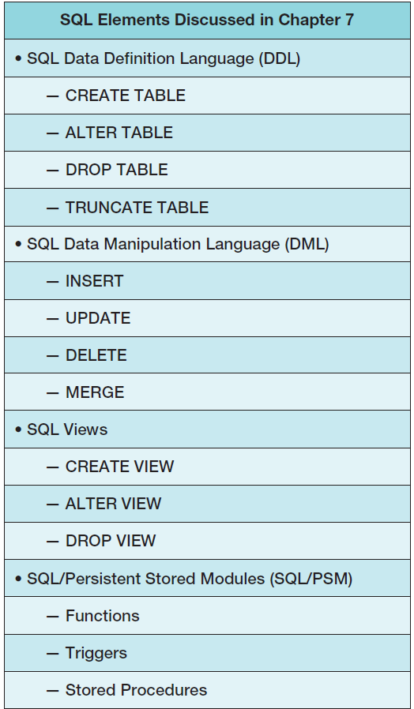
Chapter 7 SQL Elements

Slide 18
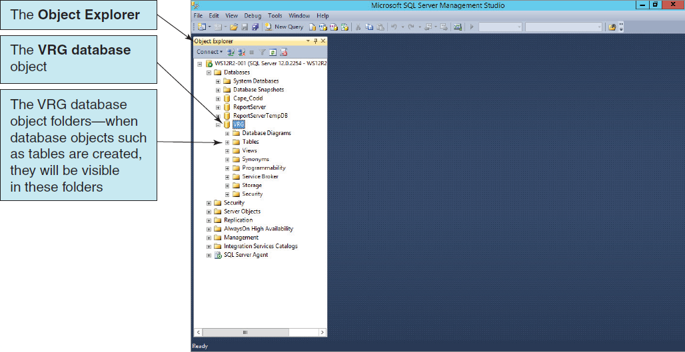
Creating the VRG Database

Slide 19
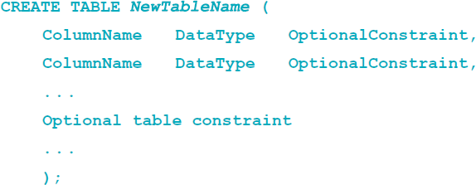
SQL CREATE TABLE Statement
CREATE TABLE statement is used for creating relations.
Each column is described with three parts: column name, data type, and optional constraints.
Format:

Slide 20
Column and Table Constraints
Constraints can be defined within the CREATE TABLE statement, or they can be added to the table after it is created using the ALTER table statement.
Column and table constraints include:
PRIMARY KEY ─ may not have NULL values
FOREIGN KEY ─ may not have NULL values
NULL / NOT NULL
UNIQUE
CHECK
The DEFAULT keyword (not a constraint)

Slide 21
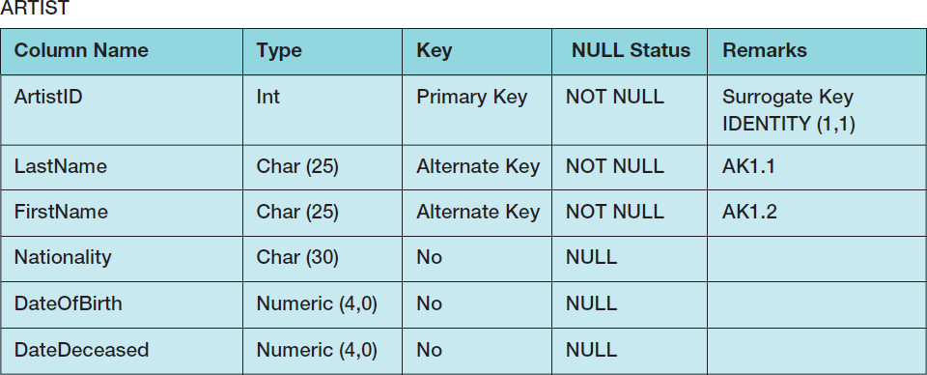
SQL CREATE TABLE Statement Example I
Column Characteristics:

Slide 22
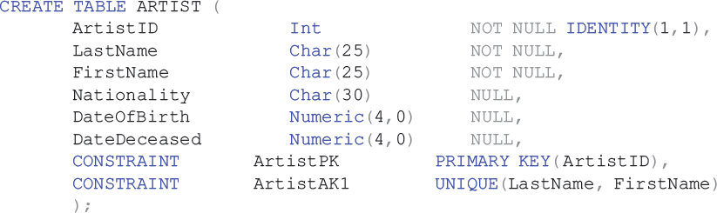
SQL CREATE TABLE Statement Example II
SQL CREATE TABLE statement:

Slide 23
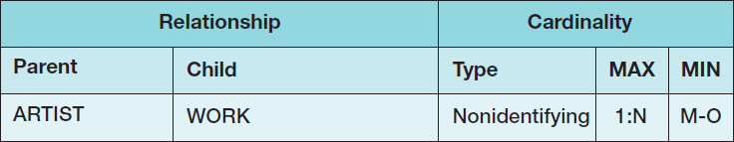
Creating Relationships I

Slide 24
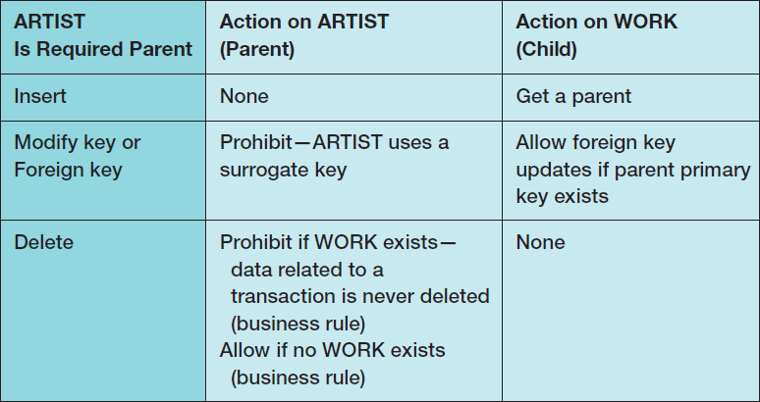
Creating Relationships II

Slide 25
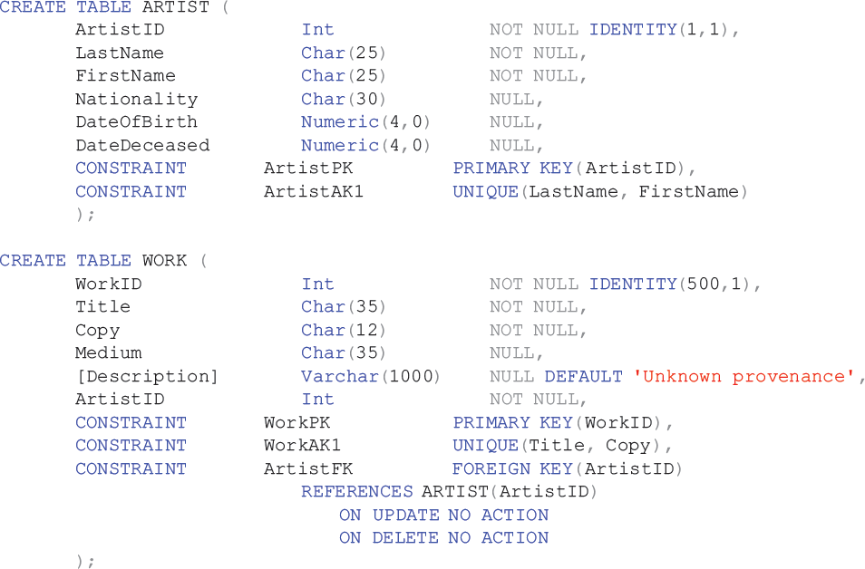
Creating Relationships III
Notes:
Note that you must define parent tables before child tables. In this case, you must define ARTIST before WORK. If you try to reverse the order of definition, the DBMS will generate an error message on the FOREIGN KEY constraint because it will not yet know about the ARTIST table.
Similarly, you must delete tables in the opposite order. You must DROP (described later in this chapter) a child before a parent. Better SQL parsers would sort out all of this so that statement order would not matter, but, alas, that’s not the way it’s done! Just remember the following: Parents are first in and last out.

Slide 26
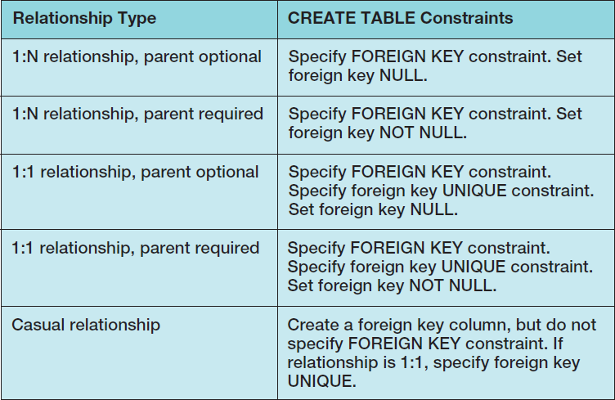
Implementing Cardinalities

Slide 27
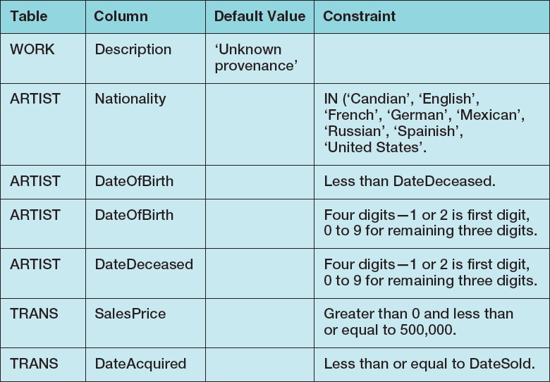
Default Values and Data Constraints

Slide 28
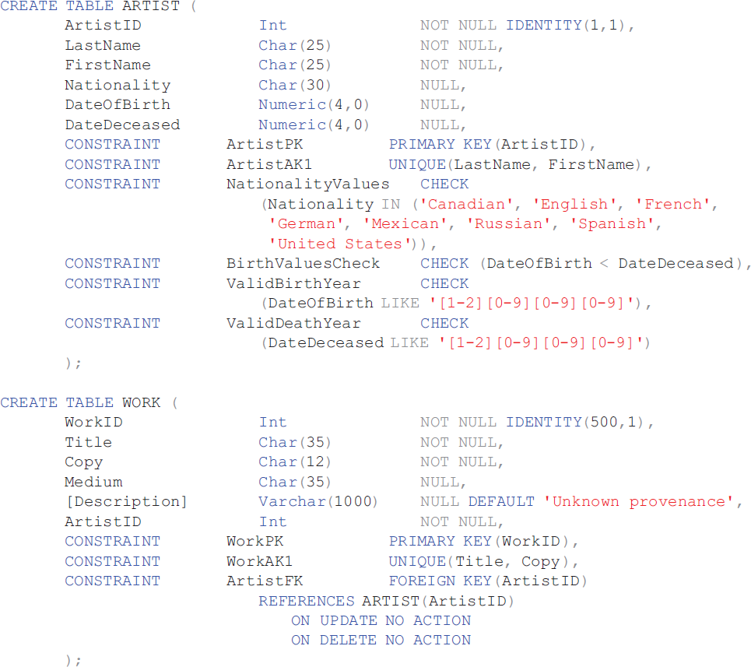
SQL for Constraints

Slide 29
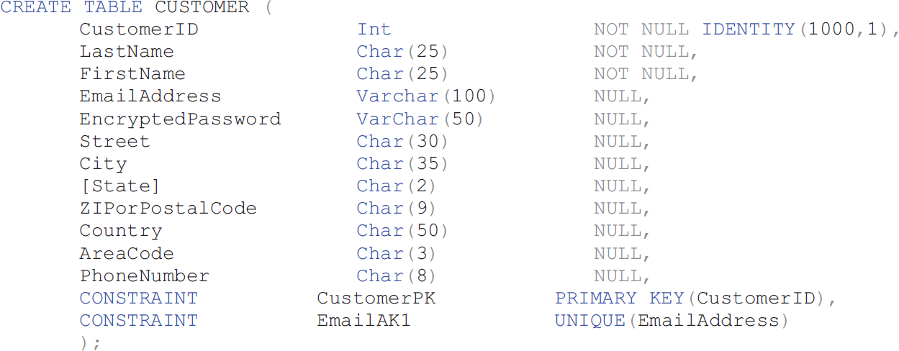
SQL for Other VRG Tables I
Notes:
IMPORTANT NOTE: There is an error in the CUSTOMER table as shown in Figure 7-13: EmailAddress is in the wrong location, and EncryptedPassword is omitted.
The version of CUSTOMER shown in this slide is correct for Microsoft SQL Server 2014.
The versions of the CUSTOMER table in the online chapters are correct:
Chapter 10A – Microsoft SQL Sever 2014 – Figure 10A-23
Chapter 10B – Oracle Database – Figure 10B-48
Chapter 10C – MySQL 5.6 – Figure 10C-31
The SQL script versions in the downloadable Student Data Files are correct!
Have your students build the VRG database using those SQL scripts.

Slide 30
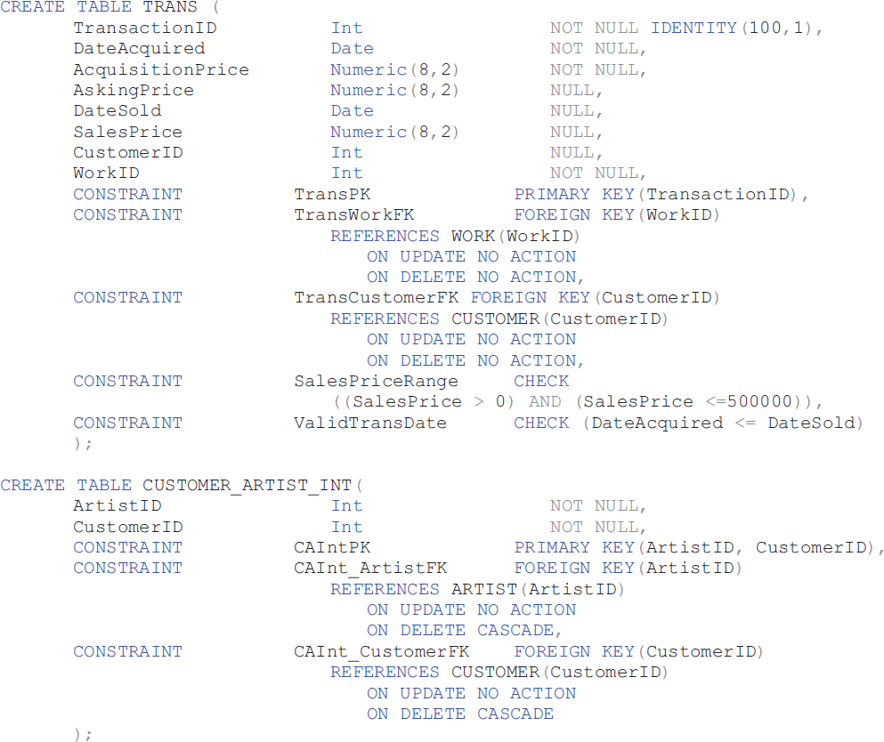
SQL for Other VRG Tables II

Slide 31
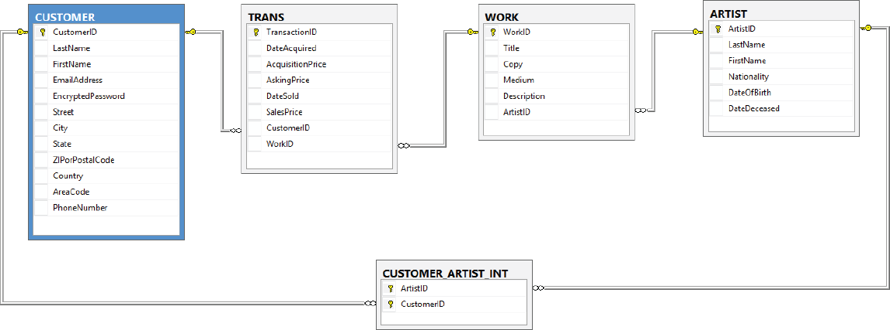
Microsoft SQL Server 2014 VRG Database Diagram

Slide 32
SQL ALTER TABLE Statement
The SQL ALTER TABLE statement changes table structure, properties, or constraints after it has been created.
Example
ALTER TABLE ASSIGNMENT
ADD CONSTRAINT EmployeeFK
FOREIGN KEY (EmployeeNumber)
REFERENCES EMPLOYEE (EmployeeNumber)
ON UPDATE CASCADE
ON DELETE NO ACTION;

Slide 33
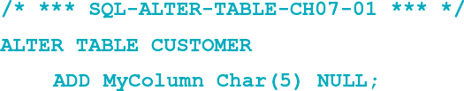

Adding and Dropping Columns
The following statement will add a column named MyColumn to the CUSTOMER table:
Note that the SQL COLUMN keyword is not used!
You can drop an existing column with the statement:

Slide 34
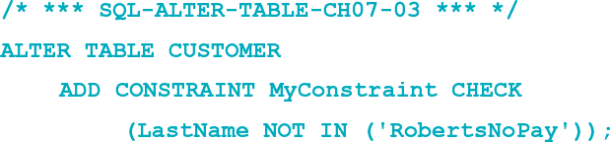
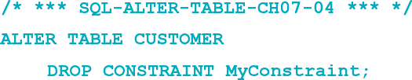
Adding and Dropping Constraints
The SQL ALTER TABLE statement can be used to add a constraint:
The SQL ALTER TABLE statement can be used to drop a constraint:
Notes:
The SQL ALTER TABLE statement can be used to add or drop any of the SQL constraints. You can use it to create primary keys and alternate keys, to set null status, to create referential integrity constraints, and to create data constraints.
In fact, another SQL coding style uses CREATE TABLE only to declare the table’s columns; all constraints are added using ALTER TABLE. We do not use that style in this text, but be aware that it does exist and that your employer might require it.

Slide 35
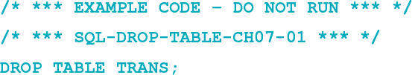
Removing Tables I
The SQL DROP TABLE statement:
If there are constraints:
ALTER TABLE CUSTOMER_ARTIST_INT
DROP CONSTRAINT Customer_Artist_Int_CustomerFK;
ALTER TABLE TRANS
DROP CONSTRAINT TransactionCustomerFK;
DROP TABLE CUSTOMER;

Slide 36
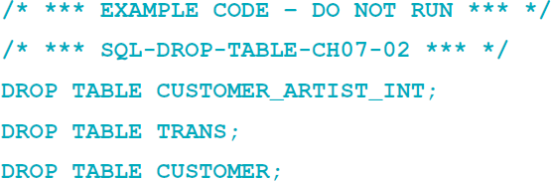
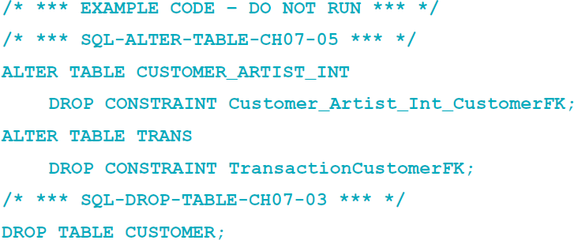
Removing Tables II
If there are constraints:
or

Slide 37
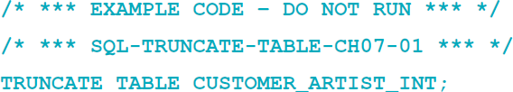
Removing Data Only
The SQL TRUNCATE TABLE statement:
Cannot be used with a table that is referenced by a foreign key constraint.
Resets surrogate key values to initial value.

Slide 38
SQL DDL—CREATE INDEX
An index is a data structure used to improve database performance.
The SQL CREATE INDEX statement
The SQL ALTER INDEX statement
The SQL DROP INDEX statement
See:
Chapter 10A - Microsoft SQL Server 2014
Chapter 10B - Oracle Database
Chapter 10C - MySQL 5.6
Notes:
Books on systems analysis and design often identify three design stages:
■ Conceptual design (conceptual schema)
■ Logical design (logical schema)
■ Physical design (physical schema)
The creation and use of indexes is a part of the physical design, which is defined in these books as the aspects of the database that are actually implemented in the DBMS.
Besides indexes, this includes physical record and file structure and organization and query optimization.
We discuss some of these issues for Microsoft SQL Server 2104 in Chapter 10A, for Oracle Database in Chapter 10B, and for MySQL 5.6 in Chapter 10C.

Slide 39
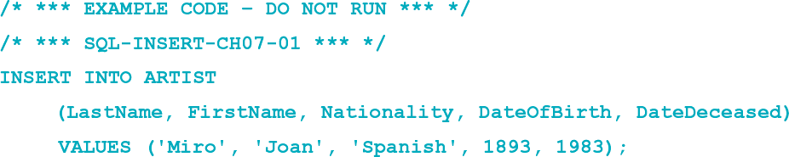
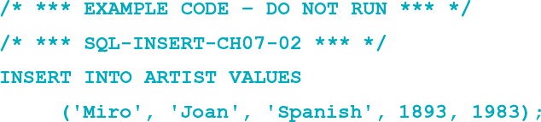
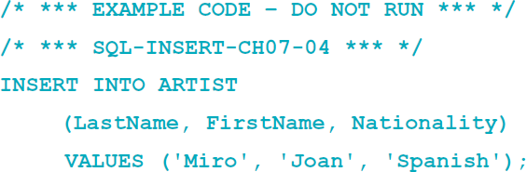
SQL DML—INSERT I
The SQL INSERT statement:

Slide 40
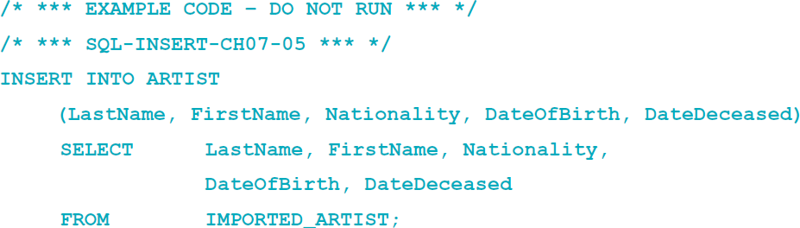
SQL DML—INSERT II
Bulk INSERT:

Slide 41
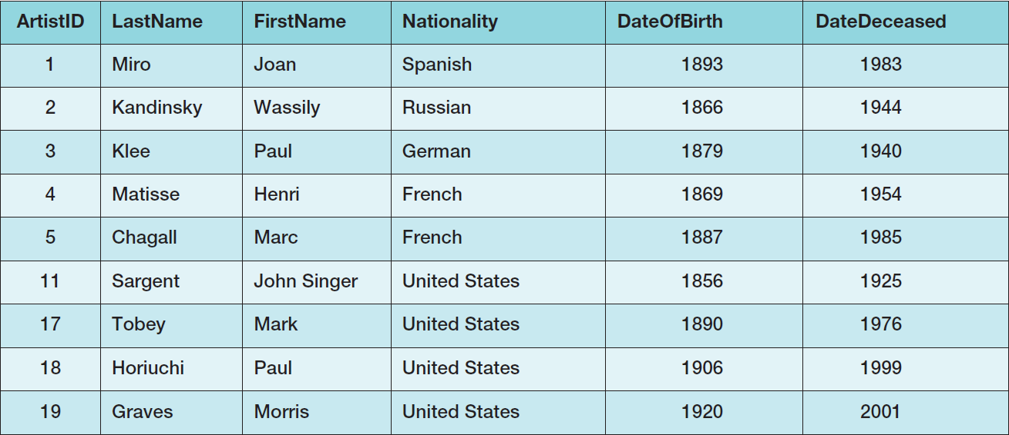
Populating the VRG Tables I
The VRG database data contain non-sequential surrogate key values.

Slide 42
Populating the VRG Tables II
Cannot just use SQL INSERT statement by itself.
See discussions of how to handle this situation:
Chapter 10A - Microsoft SQL Server 2014
Chapter 10B - Oracle Database
Chapter 10C - MySQL 5.6

Slide 43
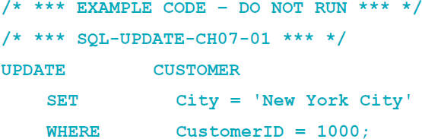
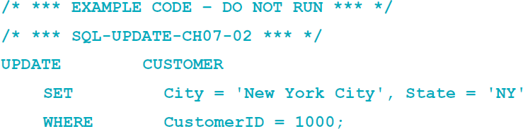
SQL DML—UPDATE I
The SQL UPDATE statement:
Notes:
The DBMS will enforce all referential integrity constraints when processing UPDATE commands.
For the VRG database, all keys are surrogate keys, but for tables with data keys, the DBMS will cascade or disallow (NO ACTION) updates according to the specification in the FOREIGN KEY constraint.
Also, if there is a FOREIGN KEY constraint, the DBMS will enforce the referential integrity constraint on updates to a foreign key.

Slide 44
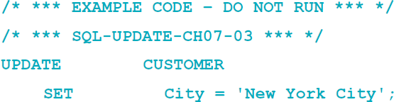
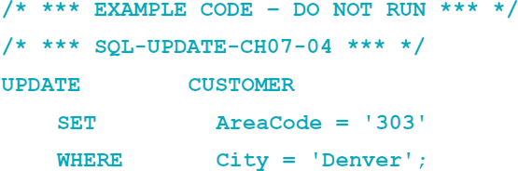
SQL DML—UPDATE II
Bulk UPDATE:

Slide 45
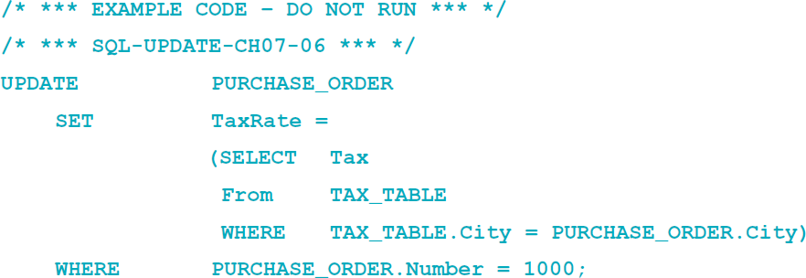
SQL DML—UPDATE III
Using values from other tables:

Slide 46
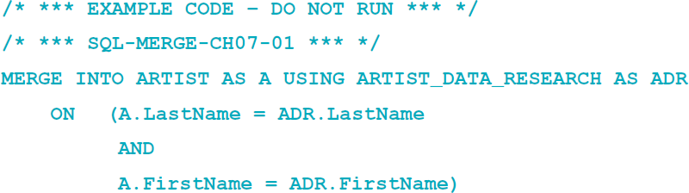
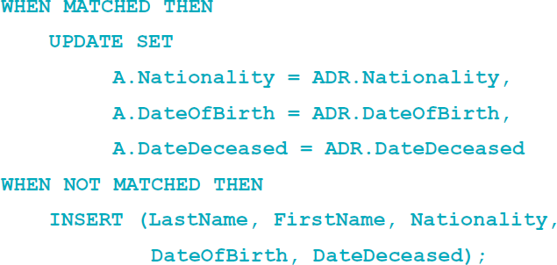
SQL DML—MERGE
The SQL MERGE statement:
Notes:
The SQL MERGE statement essentially combines the SQL INSERT and SQL UPDATE statements into one statement that can either insert or update data depending upon whether some condition is met.

Slide 47
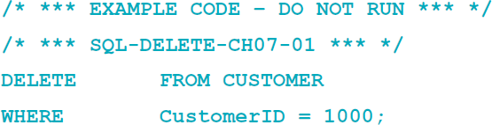
SQL DML—DELETE
SQL DELETE statement:
If you omit the WHERE clause, you will delete every row in the table.
Does not reset surrogate key values.

Slide 48
Using Aliases
Use of aliases:
SELECT C.Name, A.Name
FROM CUSTOMER AS C
JOIN
CUSTOMER_ARTIST_INT AS CI
ON C.CustomerID = CI.CustomerID
JOIN ARTIST AS A
ON CI.ArtistID = A.ArtistID;
DBMS products differ
CUSTOMER AS C versus CUSTOMER C

Slide 49
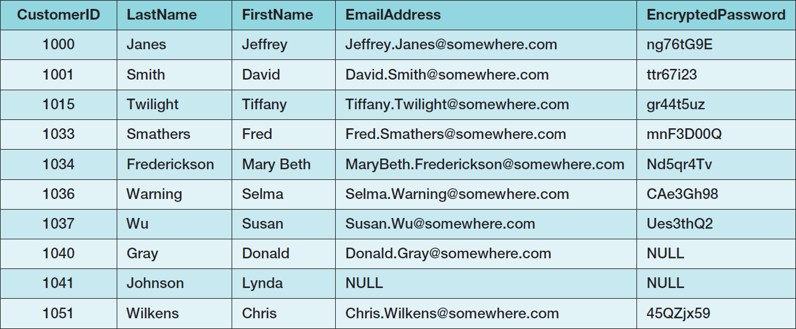
VRG Database Data CUSTOMER I

Slide 50
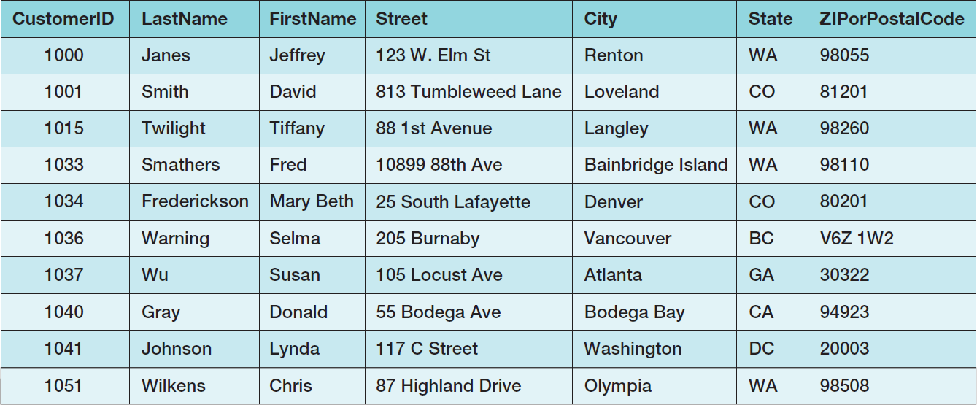
VRG Database Data CUSTOMER II

Slide 51
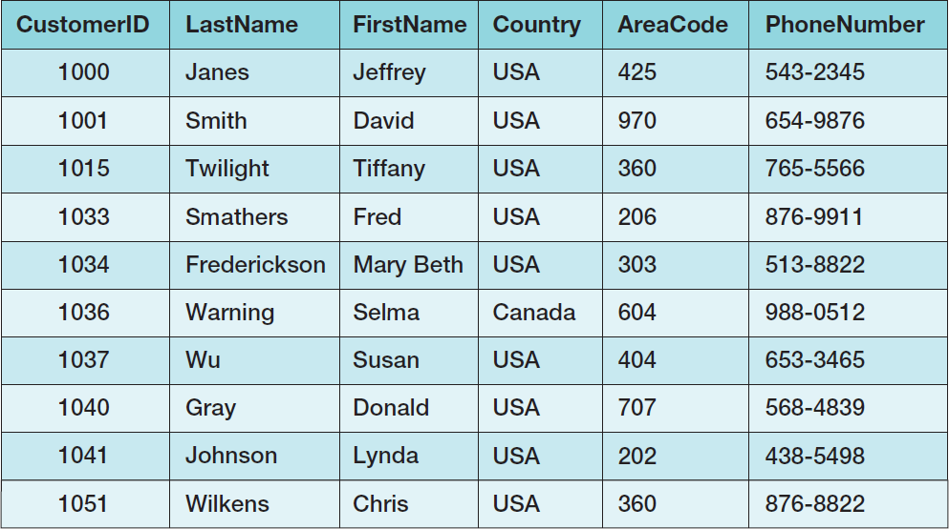
VRG Database Data CUSTOMER III

Slide 52
VRG Database Data ARTIST

Slide 53
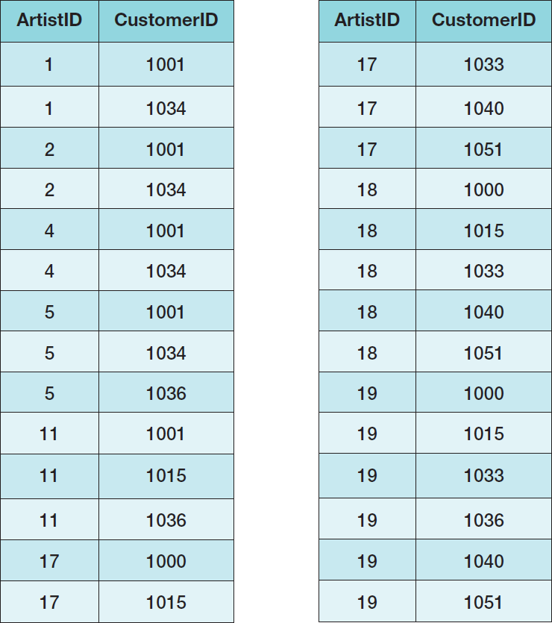
VRG Database Data CUSTOMER_ARTIST_INT

Slide 54
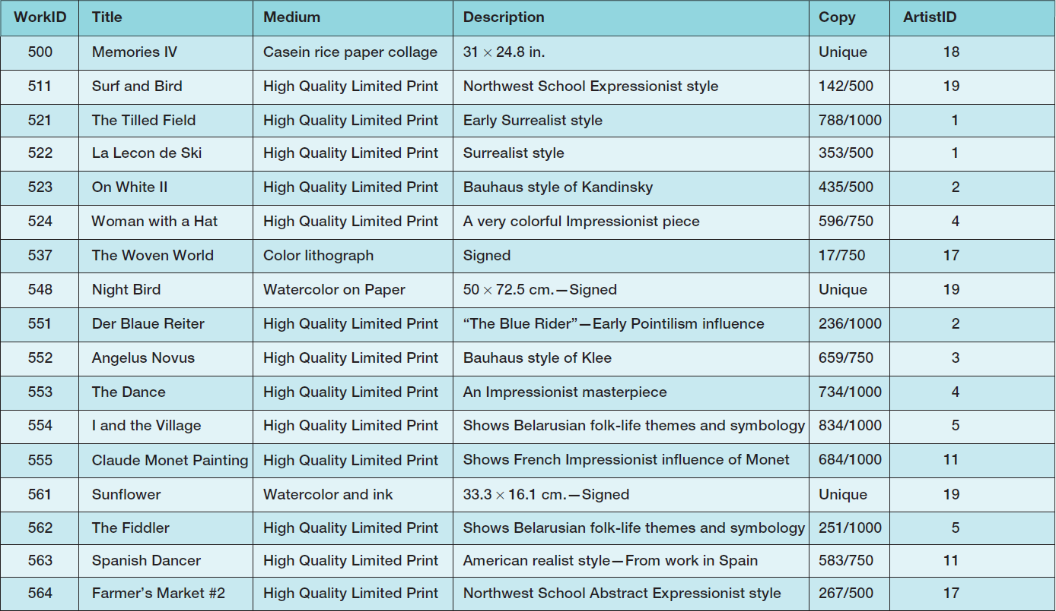
VRG Database Data WORK I

Slide 55
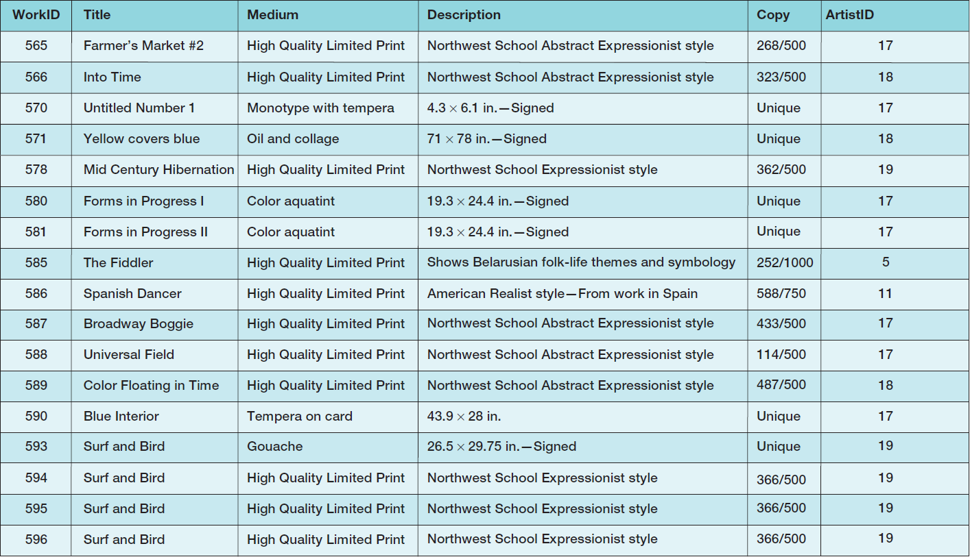
VRG Database Data WORK II

Slide 56
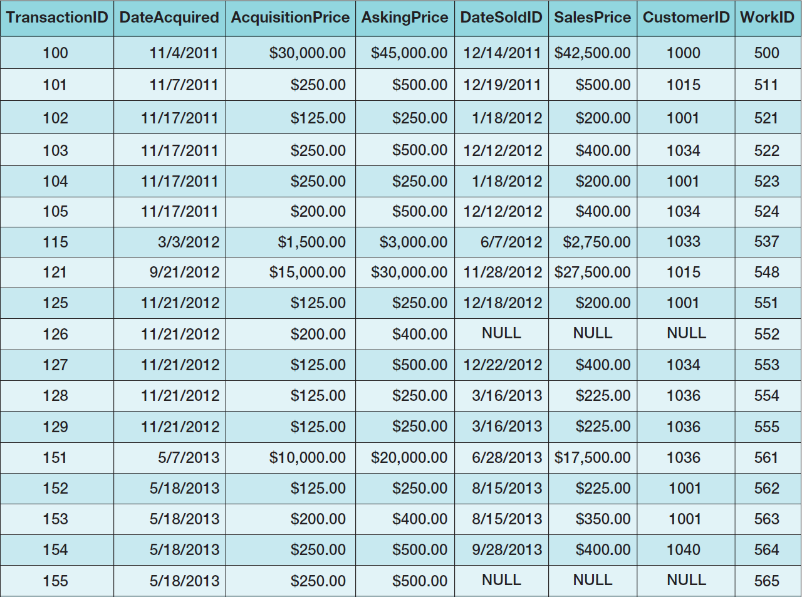
VRG Database Data TRANS I

Slide 57
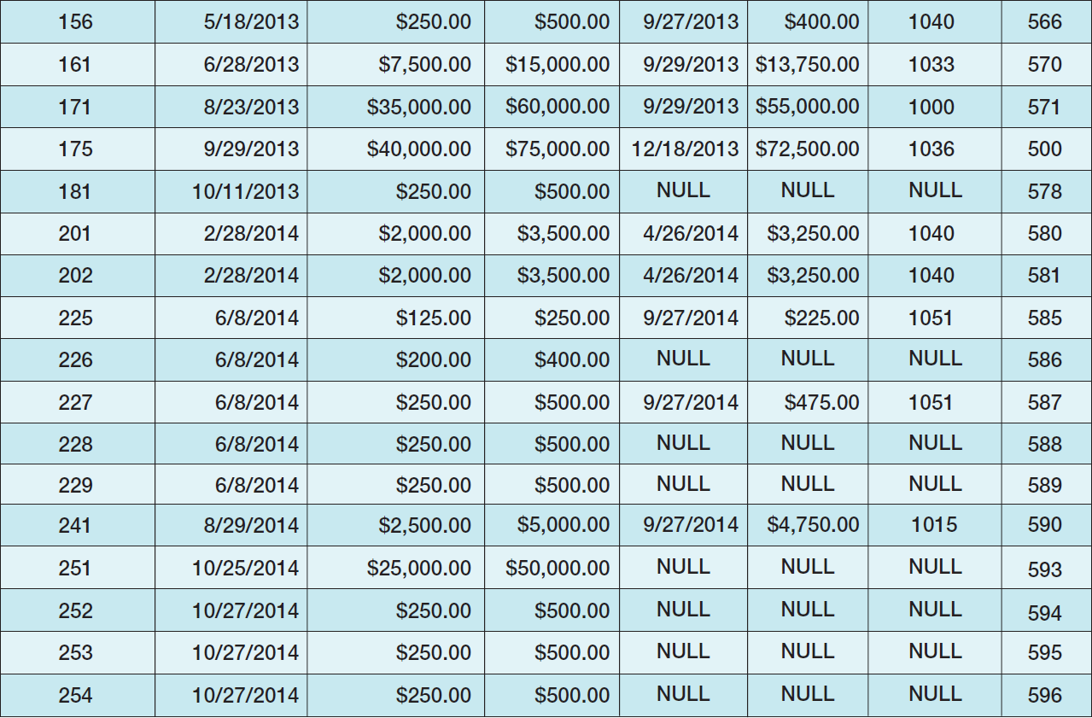
VRG Database Data TRANS II

Slide 58
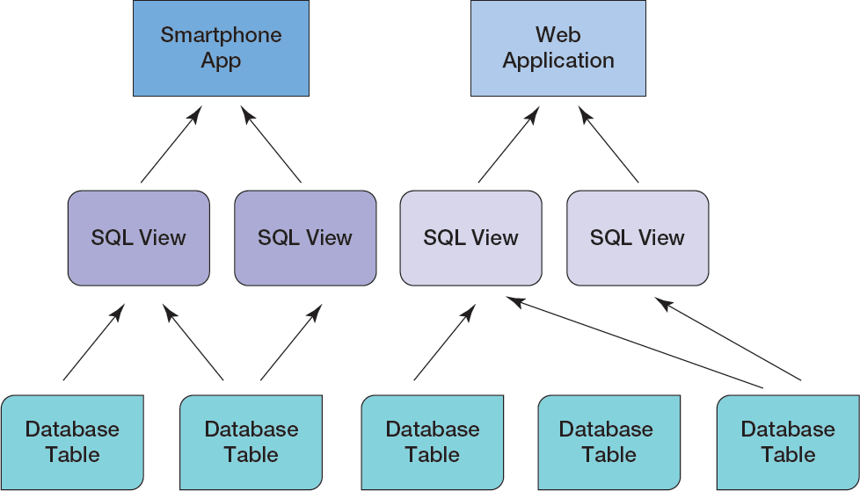
SQL Views I

Slide 59
SQL Views II
An SQL view is a virtual table that is constructed from other tables or views.
It has no data of its own, but obtains data from tables or other views.
SELECT statements are used to define views:
A view definition may not include an ORDER BY clause.
SQL views are a subset of the external views:
They can be used only for external views that involve one multivalued path through the schema.
Notes:
Views are a standard and popular SQL construct. Microsoft Access, however, does not support them.
Instead, in Microsoft Access, you can create a view-equivalent query, name it, and then save it. You can then process the query in the same ways that we process views in the following discussion.
SQL Server, Oracle Database, and MySQL all support views, and they are an important structure with many uses.
Do not conclude from Microsoft Access’s lack of support that views are unimportant. Read on, and, if possible, use SQL Server, Oracle Database, or MySQL to process the statements in this section.

Slide 60
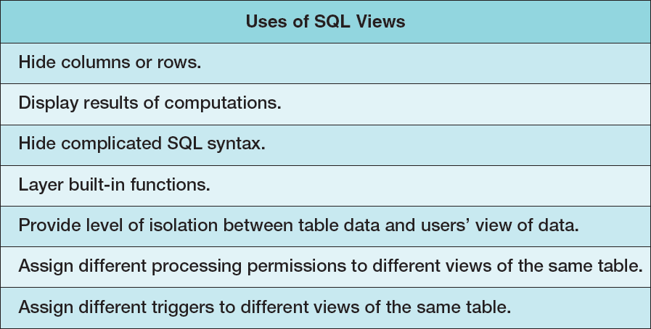
SQL Views

Slide 61
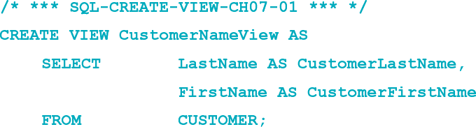
SQL CREATE VIEW Statement I
The SQL CREATE VIEW statement:
In the SQL standard, views do not support the SQL ORDER BY clause.
Individual DBMS products may support the SQL ORDER BY clause – see documentation.

Slide 62


SQL CREATE VIEW Statement II
To see the results, use an SQL SELECT statement with the view name as the table name in the FROM clause:

Slide 63

SQL ALTER VIEW Statement I
The SQL ALTER VIEW statement:
In the Oracle Database or MySQL 5.6, use the SQL CREATE OR REPLACE VIEW statement.
This allows creation and modification of SQL VIEW code.

Slide 64

Updateable Views

Slide 65
Embedding SQL in Program Code
SQL cursors are used to select one row at a time from pseudo-files.
Problem: assigning SQL table columns with program variables
Solution: object-oriented programming, PL/SQL
Problem: paradigm mismatch between SQL and application programming language:
SQL statements return sets of rows; an application works on one row at a time
Solution: process the SQL results as pseudo-files

Slide 66


Variables in Program Code
Oracle Database and MySQL 5.6 style variables:
Microsoft SQL Server 2014 style variables:

Slide 67

SQL Cursors in Program Code
SQL can be embedded in triggers, stored procedures, and program code.
A typical cursor code pattern is:

Slide 68
SQL/Persistent Stored Modules (SSL/PSM)
SQL/Persistent Stored Modules (SQL/PSM) is an ANSI/ISO standard for embedding procedural programming functionality into SQL
Each DBMS product implements SQL/PSM in a different way, with some closer to the standard than others.
Microsoft SQL Server 2014 calls its version Transact-SQL (T-SQL).
Oracle Database calls its variant Procedural Language/SQL (PL/SQL).
MySQL 5.6 implements SQL/PSM, but has no special name for its variant of SQL.

Slide 69

User-Defined Functions I
A user-defined function (stored function) is a stored set of SQL statements that:
is called by name from another SQL statement
may have input parameters passed to it by the calling SQL statement, and
returns an output value to the SQL statement hat called the function.

Slide 70

User-Defined Functions II The NameConcatenation Function

Slide 71


User-Defined Functions III The NameConcatenation Function
Using the NameConcatenation function:

Slide 72


User-Defined Functions IV The NameConcatenation Function
Partial results:

Slide 73
Triggers I
A trigger is a stored program that is executed by the DBMS whenever a specified event occurs on a specified table or view.
Three trigger types: BEFORE, INSTEAD OF, and AFTER
Each type can be declared for Insert, Update, and Delete.
Resulting in a total of nine trigger types.
Oracle supports all nine trigger types.
SQL Server supports six trigger types (INSTEAD OF and AFTER).
MySQL supports six trigger types (BEFORE and AFTER).

Slide 74

Triggers II

Slide 75
Firing Triggers
When a trigger is fired, the DBMS supplies:
Old and new values for the update
New values for inserts
Old values for deletions
The way the values are supplied depends on the DBMS product.
Trigger applications include:
Providing default values
Enforcing data constraints
Updating views
Performing referential integrity actions

Slide 76


Slide 77


Slide 78


Slide 79


Slide 80
Stored Procedures
A stored procedure is a program that is stored within the database and is compiled when used.
In Oracle, it can be written in PL/SQL or Java.
In SQL Server, it can be written in TRANSACT-SQL.
Stored procedures can receive input parameters and they can return results.
Stored procedures can be called from:
Programs written in standard languages, e.g., Java, C#.
Scripting languages, e.g., JavaScript, VBScript.
SQL command prompt, e.g., SQL Plus, Query Analyzer.

Slide 81

Stored Procedure Advantages

Slide 82


Slide 83


Slide 84

Triggers vs. Stored Procedures

Slide 85

Functions, Triggers, and Stored Procedures

Slide 86

Database Design and Implementation Summary

Slide 87
David Kroenke and David Auer Database Processing Fundamentals, Design, and Implementation (14th Edition)
End of Presentation:
Chapter Seven

Slide 88

All rights reserved. No part of this publication may be reproduced, stored in a retrieval system, or transmitted, in any form or by any means, electronic, mechanical, photocopying, recording, or otherwise, without the prior written permission of the publisher. Printed in the United States of America.

